Slide 1
Peering vs Transit Economics : The Peering Simulation Game
William B. Norton
Executive Director
DrPeering International
wbn@DrPeering.net
http://DrPeering.net/wbn
11-12 August 2010 11:00-13:00 Nairobi, Kenya Sarova Panafric Hotel Nairobi
This work was sponsored in part
by ISOC and DrPeering.net
African Peering and Interconnection Forum: Unlocking Africa’s Regional Interconnection
Notes:
Today, you are going to live the life of a Peering Coordinator.
Welcome to the Peering Simulation Game.
Four of you will join me up here on stage to build an ISP network. You will roll the dice, expand your network, acquire customers and, if you decide to build into Internet Exchange Points, you will negotiate peering.
Right here. Live.
I’ve done this simulation in about 25 forums around the world and the negotiations heard between the players in the game bear a striking resemblance to the negotiations heard in real peering negotiations.
---------------
How does that sound? Would you like to play the Peering Simulation Game?
First, I want to briefly introduce myself so you know who I am,
Second, we are going to learn the lingo, at least enough to allow you to play the game, and then
We play the peering simulation game

Slide 2
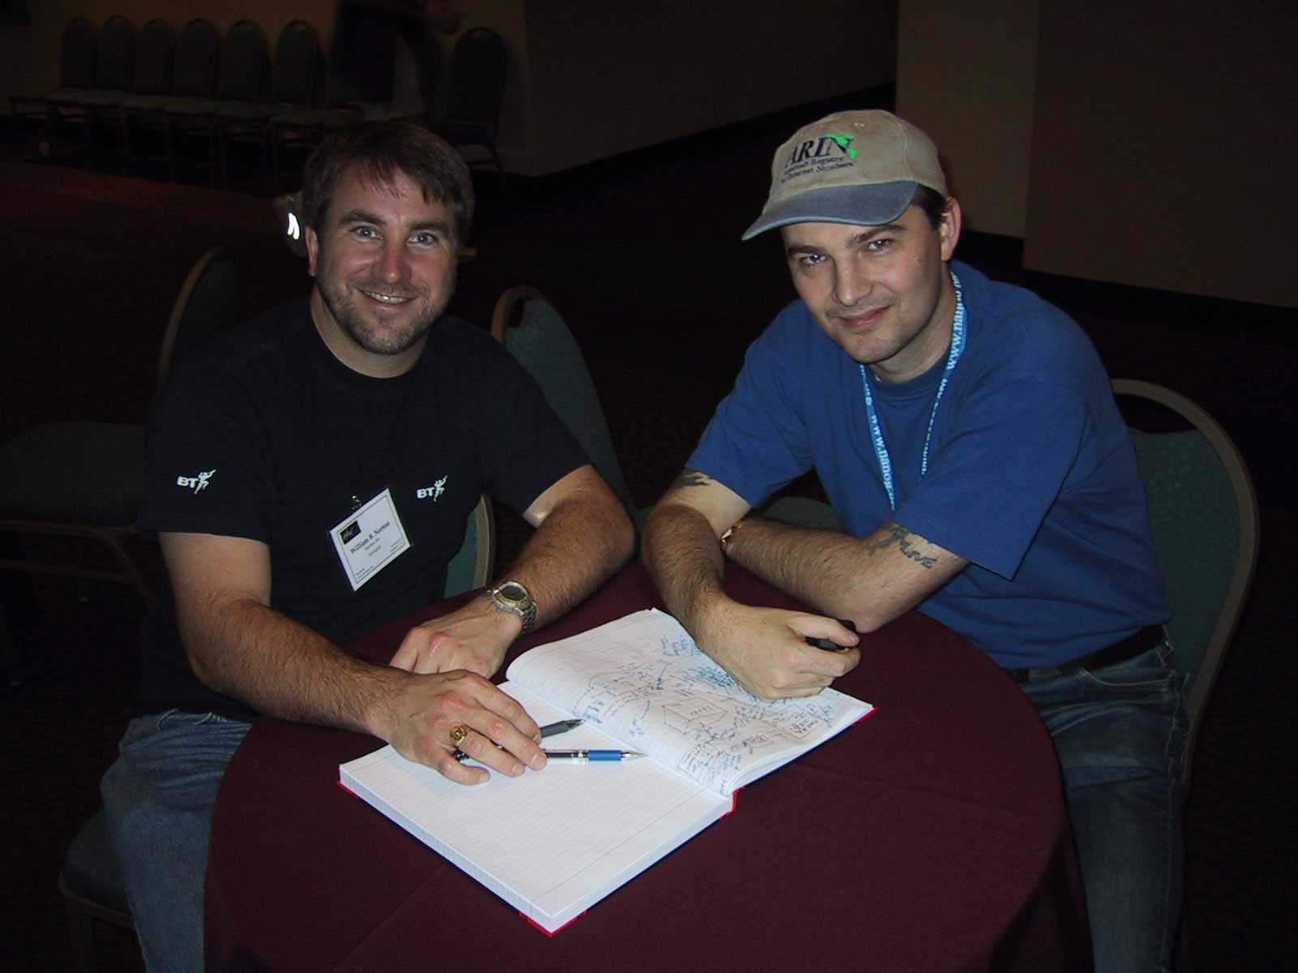
Background
1987 – building
Internet Ops community
1998 – building
Peering Intelligence
2008 – consulting,
education
Notes:
From 1987 to 1998 I was involved with the NSFNET Project, which expanded and operated the core of the Internet at the time. In 1995, as the Internet core went through commercialization, I was given the task of chairing NANOG - the operations forum for the North American Internet. It was an exciting time.
First, the Internet experienced exponential growth, and
Second, my mother started hearing the word Internet and started introducing me as the son who “works on the InterCom”, but
Most importantly, chairing NANOG helped me form the foundation relationships that would prove invaluable when I left Michigan to join Jay Adelson and Al Avery in building Equinix in 1998.
As a recently minted MBA, I was now Co-Founder but didn’t have as thorough an understanding of the Internet Peering market as Jay and Al did, running the PAIX for all of those years. So it was during those ten years at Equinix that my focus was on truly understanding the market – the market for Internet Peering, and more importantly the Internet Peering Ecosystem.
So to learn how Internet Peering worked, I went to document the undocumented - Why people peer, why they don’t, what were the working definitions of peering and what happens when you peer in another country?, how do ISPs select an IX, etc. I spoke with a lot of people and traveled to conferences around the world, and documented everything that I learned in the form of white papers. Over ten years these white papers were the resources for Internet Peering that reflect the peering community view of Peering as an Internet Operations topic.
When I retired in 2008 I rewrote and updated many of the white papers and continue to make them freely available for the global peering community that was so gracious to share all of that information with me.
So that is where I am coming from. As the game plays, I will ask the players questions and share examples of how the game mirrors real peering discussions on the Internet. And in this way, I will use stories to impart some of these two decades of Internet and Peering experience.

Slide 3
DrPeering.net Peering Resources
Internet Service Providers and Peering
A Business Case for Peering
About the White Paper Process
The Art of Peering - The Peering Playbook
The Art of Peering - The IX Playbook
Chief Technical Liaison
Ecosystems: 95th Percentile Measurement for Internet Transit
Asia Pacific Peering Guidebook
Evolution of the U.S. Peering
Emerging Video Internet Ecosystems
European vs US Internet Exchange Points
Internet DataCenter Build vs Buy Decision
Internet Service Providers and Peering
Internet Transit Pricing Historical and Projections
Modeling the value of an Internet Exchange Point
NANOG History
Peering: Motivations to Peer
A Study of 28 Peering Policies
Peering Simulation Game
Peering: Top 10 Ways to Contact Peering Coordinators
Peering: Top 10 Reasons NOT to peer
Public vs Private Peering - the Great Debate
The Folly of Peering Ratios
Top 9 IX Selection Criteria
Video Internet - The Next Wave of Massive Disruption to the U.S. Peering Ecosystem
All freely available
Notes:
I would like to share with you all a pointer to some community Internet Peering resources that are freely available on the DrPeering web site. These white papers are all truly free; you don’t need even to register to access them. The way I figure it, for 10 years the Peering Community was kind enough to share their Internet Peering knowledge and insights with me, so it is best for me to reflect this information freely back to the broader community. Many of these white papers are taught at universities. Many are used by Internet Exchange Point Operators to help bring their engineers and customers up to speed on Internet Peering. In any case I continue to hear stories of people using them and I would love to hear from you if you find them valuable.
I would especially like to highlight three of the white paper for you:
Internet Service Providers and Peering presents the definitions and the processes of peering
Secondly, The art of peering- the peering playbook highlights the tricks of the trade that the smartest peering coordinators in the world said helped them get peering where they otherwise would not have been able to get peering,
And finally, The art of peering – the IX playbook will be essential knowledge for exchange point operators to understand the competitive landscape and the dynamics of starting and competing IXPs. It describes the tactics that represent 99% of the heavy lifting that is launching an IX – it is not simply installing an ethernet switch. to turn an ethernet
Since several regions are expanding their Internet infrastructure over the next few years, it is very important that you truly understand the material in these white papers. Today I will walk you through some of the essentials.

Slide 4
Internet Peering Lexicon
“10 minute Peering Tutorial”
And then
Live the Life: Peering Simulation Game
Notes:
To start, let’s make sure that we are all using a common lexicon. This is especially important for those with a PSTN background as both the Internet side and the telephony side share some of the same words and they don’t mean the same things.
For example, at an IIR conference in London a few years back, a telco would ask a question like “When I place a web call from my browser to Yahoo!, how do the intermediary ISPs get reimbursed for their part of the transaction?”
That is where the Internet Service Providers and Peering paper came from, but to really bring it on home, I thought “Wouldn’t it be great if we could simulate the peering activity highlighting the motivations and the math involved.
After concluding it was too complicated to do I started applying simplifying assumption after simplifying assumption until we have what you will see today. A participative way to learn and understand peering. It has always been successful in engaging, entertaining and educating all at the same time.
So in this tutorial sequence we will bring everyone up to speed with some quick definitions and get right into playing the game.

Slide 5
Def: The Internet is a network of networks.
Def: ISP sells access to the Internet, so...
An ISP must itself get attached to an ISP already attached to the Internet.
Def: ‘Transit’ is service whereby one ISP sells access to the Internet.
“A port in the wall that says ‘Internet this way’”
Blue
ISP
Transit Service
Upstream
ISP
metered
95th percentile...
95th
Notes:
At the most basic level, understand that the Internet is a network of networks.
An Internet Service Provider by definition sells access to the Global Internet.
So, an Internet Service Provider must itself get attached to an entity that is already attached to the global Internet.
There are two dominant methods for Internet interconnections.
Transit is defined as a service whereby one ISP sells access to the global Internet. Think of it as a port in the wall that says “Internet this way”.
To illustrate, let’s assume you are starting an ISP service called “Blue ISP”. You purchase transit from an “Upstream ISP” who is already connected to the global Internet.
Your “Upstream ISP” will handle everything for you. The Upstream ISP makes sure that your packets get to the right place on the global Internet, and make sure that the the rest of the Internet knows how to get to you and your customers.
Transit is typically a metered service; every 5 minutes a measure is taken, and at the end of the month, the samples are stacked lowest to highest. The 95th percentile measure is the volume upon which your transit service is billed.

Slide 6
Billing Internet Transit: 95th Percentile
1 month of 5 min Samples=vn - vn-1
Highest Monthly
Sample
}~36 hrs/month to burst for free
:
:
:
134Mbps
95th
Percentile measure (aka 95P)
:
:
Blue
ISP
Transit Service
Lowest
Monthly Sample
1Mbps
Dropping transit fees
Notes:
Let’s examine the metering of the transit service a more closely.
The meter on the transit service spins as you send and receive more and more traffic across your Internet transit service.
Every 5 minutes, the count of how many bytes went across the pipe is taken. The delta between the previous measure and this measure is calculated and stored.
With 12 samples per hour, 24 hours in a day, and between 28 and 31 days per month of samples; there are 8 to 9 thousand 5-minute samples each month.
The samples are stacked lowest to highest and the 95th percentile is the volume upon which your metered rate is calculated.
The 95th percentile also means that, for 5 percent of the time, which is about 36 hours, you can burst your traffic up to capacity of the transit pipe, and it won’t cost you anything more. It is only that 95th percentile volume measurement that is used to calculate your transit bill at the end of the month.

Slide 7
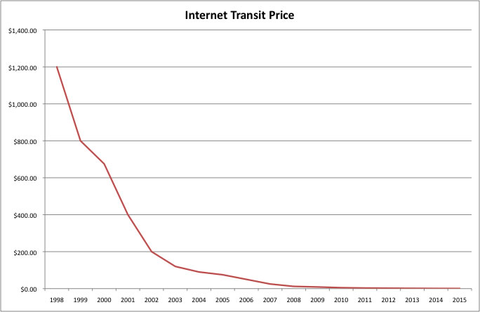
U.S. Internet Transit Pricing
1999 $1200/Mbps
2004 $120/Mbps
2008 $12/Mbps
2010 $5/Mbps
Source: “Transit Pricing Historical and Projected”
http://DrPeering.net
Notes:
In the U.S. the price of transit has dropped dramatically.
When I first started with Equinix in 1998 the going rate for Internet transit was $1200 per Mbps.
In 2004 it was $120 per Mbps
In 2008 is was $12 per Mbps
And today in 2010 it is approaching $1.20.
One consistency is that the drop continues. Another consistency is that ISPs claim that noone can make any money at these prices. And the transit prices drop some more.
If transit is so cheap and simple, why do we care about peering? This is a good question and one that comes up at every Internet operations forum.

Slide 8
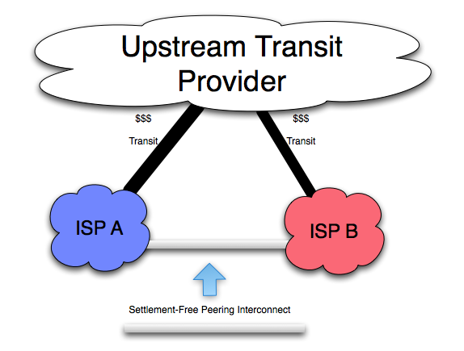
So Why Peer?
100 ISPs surveyed…
Bypass metered transit
#1 Lower Transit Costs.
#2 Lower Latency.
#3 Usage-based traffic billing.
4) Marketing Benefits
Source: http://drpeering.net/white-papers/Peering-Motivations-to-Peer.html
Notes:
So why peer?
I asked the peering coordinators about their motivation. If transit is simple, why do you peer? Here are the top 4 answer to that question.
One view is that Internet Peering is local routing optimization.
1) It lowers transit costs,
2) provides better performance – the shortest path between two points is straight line, right?
3) If your customers get better performance they use it more
4) Peering signals competence
Let’s now define peering.

Slide 9
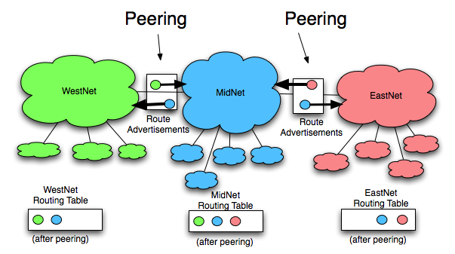
Definition of Internet Peering
Def: Peering is the business relationship whereby ISPs
reciprocally announce reachability to each others’ transit customers.
Notes:
Peering is defined as a business relationship whereby two ISPs reciprocally announce reachability to each others’ customers.
In the example above, we see three networks: WestNet (shown in green with little green downstream customers), MidNet (shown in blue with little blue downstream customers), and EastNet (shown in Red with little Red downstream customers).
We see that WestNet is in a Peering relationship with MidNet whereby WestNet announces reachability of its green customers to MidNet, and MidNet reciprocally announces reachability to its blue customers to WestNet.
With this peering relationship, We see that WestNet has a routing table that includes how to reach both Blue MidNet customers as well as Green WestNet customers.
Likewise We see that EastNet is in a Peering relationship with MidNet whereby EastNet announces reachability of its Red customers to MidNet, and MidNet reciprocally announces reachability to its blue customers to EastNet.
With this peering relationship, We see that EastNet has a routing table that includes how to reach both Blue MidNet customers as well as its own Red EastNet customers.
With both of these peering relationships we see that MidNet has a routing table that includes how to reach Green WestNet, Blue MidNet, and Red EastNet customers
It is also important to notice that Peering is NOT A TRANSITIVE RELATIONSHIP – that is, just because WestNet peers with MidNet and MidNet peers with EastNet, does not imply that WestNet can reach EastNet through MidNet.

Slide 10
Some context : The Internet Peering Ecosystem
Internet viewed as a Global Internet Peering Ecosystem
Notes:
Now we are ready to apply the definitions we have just learned by looking holistically at the Internet Peering Ecosystem.

Slide 11
Def: Global Internet Peering Ecosystem consists of a set of interconnected internet regions (countries).
Global Internet Peering Ecosystem
JP Internet Region
AU Internet Region
US Internet Region
Tier 1 ISPs
Tier 2 ISPs
Content Providers
Characteristics of these
Ecosystem Organisms?
Notes:
Now to take a giant step back we see that the big “I” Internet consists of a set of ecosystems that I call the Global Peering Ecosystem. The Global Internet Peering Ecosystem has many interconnected Internet regions. You can think of and Internet Region as a country and you’d be mostly correct.
From my research, I have found that each Internet Region contains three distinct types of species of ISPs, and I will reclaim the following names for each species.
There are Tier 1 ISPs that have access to the entire Internet Region solely through free peering relationships.
There are Tier 2 ISPs that have to buy transit from someone in order to reach some destinations in the Internet Region.
And there are Content Providers who do not sell Internet Transit.
Let’s examine each species in turn.

Slide 12
Ecosystem Member: Tier 1 ISP
P
Def: A Tier 1 ISP is an ISP
that has access to the
ENTIRE Internet Region Routing Table
Solely via Peering Relationships
Tier 1 ISP
P
$
…
$
T
T
(Doesn’t buy transit from anyone
to reach any destination in the
Internet Region.)
Motivation: Is NOT motivated to
Peer in region to reduce transit fees,
Is NOT motivated to peer with
anybody else.
Behavior: “Restrictive” Peering
*def: Policy
Notes:
First, let’s look at the Tier 1 ISP species.
I have drawn a picture to illustrate its essential characteristics so you can identify them in the wild.
The Tier 1 ISP sells transit to downstream ISPs and Content Providers, as shown by the lines coming out the bottom and the dollar signs towards the top of these transit lines. He also Peers with other Tier 1 ISPs in order to reach destinations that aren’t on his network but exist within the Internet Region.
Since the Tier 1 ISP by definition doesn’t buy transit from anyone to reach any desitnation within the Internet Region, there is no motivation top peer with anyone else. In fact, there are disincentives to peer with anyone else, since they or their peers would lose revenue by peering with others.
As a result, the Tier 1 ISP tends to have a “Restrictive Peering Inclination”, as articulated in a “Restrictive Peering Policy”. The Tier 1 ISPs of course do not call their peering policy a restrictive peering policy; they would use words like ‘We will peer with networks of similar size and scale’, but research has shown that very few true Tier 1 ISPs are openly interested in peering with any other ISPs within the Internet Region in which they are Tier 1 ISP.

Slide 13
$
$
Ecosystem Member: Tier 2 ISP
T
…
T
P
Def: A Tier 2 ISP is an ISP
that has to purchase Transit to access
some part of the Internet Region.
Tier 2 ISP
P
$
…
$
T
T
Motivation: Is motivated to
Peer in region to reduce transit fees.
Behavior: “Open” Peering or
“Selective” Peering Policy
Active in Peering Forums
Notes:
A Tier 2 ISP is just like a Tier 1 ISP except that he has to purchas transit from someone in order to reach some destinations within the Internet Region. These upstream transit connections are shown as the lines going up off the top, to the dollar signs indicating that there is money or something of value exchanged to an upstream.
The Tier 2 ISP peers openly or selectively with other Tier 2 ISPs and even Content Providers, for the reasons explained earlier. If peering can reduce its transit costs, improve performance for its customers, increase revenue, or a fitting combination of these, the Tier 2 ISP is generally open to peering.
For these reasons, you will be able to find Tier 2 ISPs at peering forums, operations conferences, and other forums where they can meet up with each other and try and negotiate peering.

Slide 14
$
$
Content Providers
T
…
T
Def: A Content Provider focuses on
content development and does not
Sell access to the Internet.
Content
Provider
Motivation: SLAs w/well known ISP
Behavior: “No Peering” Policy
Notes:
Content Providers don’t sell transit, so they are shown with no lines out the bottom, and only lines up to their upstream transit provider.
It is important to note that the vast majority of Content Providers are focused on content creation, and may have few or no networking people to talk about peering. They are often quite happy to buy transit at today’s low prices and let someone else deal with thte delivery of their traffic to the global Internet.
When we discuss the evolution of the Peering Ecosystem in the U.S. we will see that some large content providers have found value in growing peering tentacles out the side.

Slide 15
Internet Peering Ecosystem
Tier 1 ISPs
Traffic and
$ flow up
T
T
T
T
Tier 2 ISPs
T
T
T
T
T
T
T
T
Active Peering Groups
Peering Forums
IX Meetings
Content Providers
Test: Apply defs…
Notes:
So when we put this architecture together we have something that looks like this.
Note that all traffic not peered at a lower level generates traffic and dollars to the Tier 1 ISPs. This is one reason it is good to be a Tier 1 ISP.

Slide 16
Quiz
2) Definition of Peering:
________________
Tier 1 ISP X
P
Tier 1 ISP Y
1) Definition of Transit:
________________
$
$
T
T
Tier 2 ISP B
Tier 2 ISP A
$
T
3) Definition of an “Open” Peering Policy: _____________________
4) Definition of a “Selective” Peering Policy: _____________________
5) Definition of a “Restrictive” Peering Policy: ____________________
Content
Provider C
Notes:
So now we have a quiz to see if you have absorbed the material.
Consider the Internet Region above, in which there are two Tier 1 ISPs; ISP X and ISP Y.
ISP X has a downstream ISP A, and ISP Y has a downstream ISP B who in turn has a content provider customer Content Provider C
Question 1: What is the definition of Internet Transit?
Question 2: What is the definition of Peering?
Question 3: What is the definition of an “Open” peering policy?
Question 4: What is the definition of a “Selective” peering policy?
Question 5: What is the definition of a “Restrictive” peering Policy?

Slide 17
Apply Defs: Peering Dynamics & Motivations
Internet Peering Ecosystem
Tier 1 ISP X
P
Tier 1 ISP Y
P?
$
$
No, like $.
T
T
No, like $,
& I Like customer
B
P?
Tier 2 ISP
B
P?
Tier 2 ISP
A
T
$
No, I already hear your routes
for FREE!
Content
Provider
Synch Point:
You have all the defs needed to predict behavior in the Peering Ecosystem.
You should be able to answer the question at hand.
Notes:
Here we will test your understanding of the peering ecosystem and definitions with the typical interactions seen in the wild.
Question: What will ISP Y most likely respond when Tier 2 ISP B requests peering?
Answer: ISP Y will respond negatively to the downstreams request. After all, it prefers the revenue generated from handling the downstream ISPs traffic, and decreasing the transit traffic decreases its revenue.
Question: What will ISP Y most likely respond when Content Provider C requests peering?
Answer: ISP Y will respond negatively to the downstream Content Provider request. After all, it prefers the revenue generated indirectly from handling the downstream ISPs transit traffic, and decreasing the transit traffic decreases its revenue. Further, by decreasing its downstream ISP’s traffic and revenue, he harms his customer. There is little or no motivation to support this peering request.
Question: What will ISP Y most likely respond when Tier 2 ISP A requests peering (remembering that ISP A is the downstream of ISP X)?
Answer: ISP Y will respond negatively to its Tier 1 peers downstreams ISP request. While he doesn’t lose revenue by peering with his peers downtreams, he doesn’t gain any benefits, and may irritate his peer, who will lose some revenue.
Hopefully this provided you with a chance to exercise and test your understanding of the key concepts presented here.

Slide 18
The Peering Simulation Game
Let’s exercise these definitions
Notes:
So now we will apply these definitions and live the life of a peering coordinator.
First, let’s volunteer our peering coordinators. We need four players or teams of players.

Slide 19
The Players
Internet Service Provider A
Peering Coordinator
Internet Service Provider B
Peering Coordinator
Internet Service Provider C
Peering Coordinator
Internet Service Provider D
Peering Coordinator
Notes:
We have four ISPs in the Peering Simulation Game that we will call ISP A, ISP B, ISP C, and ISP D
At this stage we bring up the four peering coordinators – only people who have never seen the Peering Simulation Game are allowed to play. Just to keep it fair.

Slide 20
3 Helpers
Transit Provider X:
Transit Provider Y:
Exchange Point Operator:
Notes:
I will also need a couple helpers. Who wants to be a Tier 1 ISP. All you need to do is extract money from the players and grunt like the knuckle dragging gorillas that you are.
And we need an exchange point operator.
Now let’s take a look at the game board

Slide 21
The Peering Game
Transit Provider X
A
B
IXN
X
X
IXW
IXE
Y
Y
IXS
C
D
Transit Provider Y
Notes:
Here we have the Peering Simulation gameboard.
Every square represents customer traffic, and each of you already have a square of customer traffic.
You will notice around the perimeter are the two Tier 1 ISPs in this Peering Ecosystem – they will be your transit providers. In this game ISP A and ISP B purchase transit from Transit Provider X, and ISP C and ISP D purchase transit from Transit Provider Y
You will also notice that there are four Exchange Points across the board – IX North, IX South, IX East and IX West.
On to the 3 rules of the game

Slide 22
3 Rules
Goal: Maximize bank holdings. Make money by acquiring customers and reduce transit costs by peering
Play: Roll the dice and expand your network by selecting that many adjacent “squares” of customers
Gain transit revenue of $2000 for each customer square you own
Pay transit fees of $1000 for each square of traffic that other ISPs own
3. If at Exchange Point, two ISPs can negotiate peering:
$2000 recurring cost and loss of 2 turns, ISPs negotiates who covers the costs of peering
Peering ISPs do not have to pay transit for each others squares starting the next turn
Quick round…
Notes:
First – the goal of the game is to maximize bank holdings. You make money by acquiring customers (rolling the dice) and you can reduce your transit fees by peering.
Second, you get transit revenues of $2000 per square you own, but you pay your transit provider $1000 in transit fees to reach every square that someone else owns.
Finally, if two ISPs are at an exchange point they can negotiate peering. But there is a cost of peering:
$2000 must be paid to the IX Operator recurring every month, and ISPs must negotiate who pays this fee or if they split it, and
Two turns to roll the dice must be forfeited which represents the engineering expense of building in, coordinating with IX and establishment of peering instead of acquiring customers
So $2000 recurring and two lost turns must come out from the peering negotiations, and once peering is established, neither party pays transit fees to access each others squares.
Note – there is no blocking in this game – multiple players can occupy the same square with no consequences
Note you can roll the dice and move vertically, horizontally or diagonally from any of your existing squares.

Slide 23
Transit Provider X
A
A
A
A
A
B
IXN
A
A rolls 5,
Wants to peer w/B – moves to IXN
Receives revenue on 6 squares (6*$2000)
Pays Transit on others squares (3*$1000)
$12,000 - $3,000 = $9,000
X
X
IXW
IXE
Y
Y
IXS
C
D
Transit Provider Y

Slide 24
Transit Provider X
A
A
A
A
A
B
IXN
A
B
B
A rolls 5,
Pays Transit on others squares (3*$1000)
Receives revenue on 6 squares (6*$2000)
$12,000 - $3,000 = $9,000
B rolls 3,
Going to IXE
Receives revenue on 4 squares (4*$2000)
Pays Transit on others squares (8*$1000)
$8,000 - $8,000 = $0
B
X
X
IXW
IXE
Y
Y
IXS
C
D
Transit Provider Y

Slide 25
Transit Provider X
A
A
A
A
A
B
IXN
A
B
B
A rolls 5,
Pays Transit on others squares (3*$1000)
Receives revenue on 6 squares (6*$2000)
$12,000 - $3,000 = $9,000
B rolls 3,
Can get to IXE
Pays Transit on others squares (8*$1000)
Receives revenue on 4 squares (4*$2000)
$8,000 - $8,000 = $0
C rolls 6,
Can get to IXW, likes IXS
Receives revenue on 7 squares (7*$2000)
Pays Transit on others squares (11*$1000)
$14,000 - $11,000 = $3,000
B
X
X
IXW
IXE
Y
C
Y
C
C
C
IXS
C
C
C
D
Transit Provider Y

Slide 26
Transit Provider X
A
A
A
A
A
B
IXN
A
B
B
A rolls 5,
Pays Transit on others squares (3*$1000)
Receives revenue on 6 squares (6*$2000)
$12,000 - $3,000 = $9,000
B rolls 3,
Can get to IXE
Pays Transit on others squares (8*$1000)
Receives revenue on 4 squares (4*$2000)
$8,000 - $8,000 = $0
C rolls 6,
Can get to IXW, IXS
Pays Transit on others squares (11*$1000)
Receives revenue on 4 squares (7*$2000)
$14,000 - $11,000 = $3,000
B
D rolls 1,
Late entrant heading to IXE
Receives revenue on 2 squares (2*$2000)
Pays Transit on others squares (17*$1000)
$4,000 - $17,000 = -$13,000
X
X
IXW
IXE
Y
C
Y
C
C
C
D
IXS
C
C
C
D
Transit Provider Y

Slide 27
Scoreboard after Round 1
ISP A: $9,000
ISP B: $0
ISPC: $3,000
ISPD: -$13,000
On to Round 2→

Slide 28
Transit Provider X
A
A
A
A
A
B
IXN
A
B
A
B
A rolls 5,
Pays Transit on others squares (3*$1000)
Receives revenue on 6 squares (6*$2000)
$12,000 - $3,000 = $9,000
B rolls 3,
Can get to IXE
Pays Transit on others squares (8*$1000)
Receives revenue on 4 squares (4*$2000)
$8,000 - $8,000 = $0
C rolls 6,
Can get to IXW, IXS
Pays Transit on others squares (11*$1000)
Receives revenue on 4 squares (7*$2000)
$14,000 - $11,000 = $3,000
B
A
D rolls 1,
Late entrant heading to IXE
Pays Transit on others squares (17*$1000)
Receives revenue on 4 squares (2*$2000)
$2,000 - $17,000 = -$15,000
A rolls 3,
Attaches to IXW
Receives revenue on 9 squares (9*$2000)
Pays Transit on others squares (13*$1000)
$18,000 - $13,000 = $5,000
Wants to peer with C – split costs?
YES: -$1,000 + both lose a turn
Neither has to pay transit to each other!
X
A
X
IXW
IXE
Y
C
Y
C
C
C
D
IXS
C
C
C
C
D
Transit Provider Y

Slide 29
Transit Provider X
A Position
9 Revenue squares
1 lost turn
Peering w/C
reduced cost $8000/turn
A
A
A
A
A
B
B
B
B
B
B
IXN
A
B
A
B
A rolls 5,
Pays Transit on others squares (3*$1000)
Receives revenue on 6 squares (6*$2000)
$12,000 - $3,000 = $9,000
B rolls 3,
Can get to IXE
Pays Transit on others squares (8*$1000)
Receives revenue on 4 squares (4*$2000)
$8,000 - $8,000 = $0
C rolls 6,
Can get to IXW, IXS
Pays Transit on others squares (11*$1000)
Receives revenue on 4 squares (7*$2000)
$14,000 - $11,000 = $3,000
B
A
D rolls 1,
Late entrant heading to IXE
Pays Transit on others squares (17*$1000)
Receives revenue on 4 squares (2*$2000)
$2,000 - $17,000 = -$15,000
A rolls 2,
Attaches to IXW
Pays Transit on others squares (13*$1000)
Receives revenue on 8 squares (8*$2000)
$16,000 - $13,000 = $3,000
Wants to peer with C – split costs?
YES: -$1,000 both lose a turn
Neither has to pay transit to each other
XA
B rolls 6,
Attaches to IXE*IXN
Receives revenue on 10 squares (10*$2000)
Pays Transit on others squares (21*$1000)
$20,000 - $21,000 = -$1,000
Wants to peer with A – split costs?
NO: You pissed me off,
Yes: if $0 & B lose both turns
Both walk away
XB
IXW
IXE
YC
Y
C
C
C
D
IXS
C
C
C
C
D
Transit Provider Y

Slide 30
Let’s play!
WELCOME TO BILLAND
4 ISPs that have never played before
Open Board
$35,000 VC Funding
We want to hear your thought process and peering negotiations
Winner - prize
$25,000 VC Funding
1¥ = $1000
WINNER: At 5:25?PM we will stop and
assume that every roll was a “3”
from that point on out to 12 rounds..

Slide 31
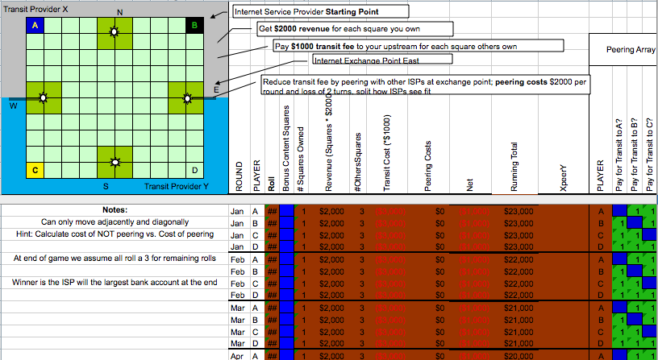
Play the Peering Simulation Game…

